Slide 1
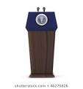
Revisiting Rhetoric: A text mining analysis of rhetoric in Political speech
Author: Jeff Bertucci

Slide 2
Introduction
Political Speeches can be broken down into two categories
Action Items: The politician setting out policy decisions they will work to make
Rhetoric: The politician using words in order to frame what they are doing, recognize individuals, or other methods to win over voters

Slide 3
State of the Union
the president “shall from time to time give to the Congress Information of the State of the Union, and recommend to their Consideration such measures as he shall judge necessary and expedient”
Originally, it was just a document that the president would submit annually to congress
Now, Thanks to President Wilson in 1913, it is a speech directed to Congress, but viewed directly by the public

Slide 4

The data
The data to be used is a cultivated dataset comprised of each recent president’s first state of the union address.
This allows for variation in types of rhetoric

Slide 5
The Goal
Separate action items out from rhetoric within political speeches
Create a basis to break down political speeches to their base components
Find a way to compare effectiveness of speeches that contain different topics
Create a metric that can be seen to have an impact over time

Slide 6
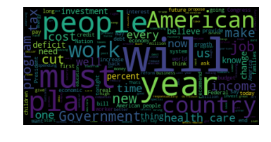
The Speeches-Clinton

Slide 7
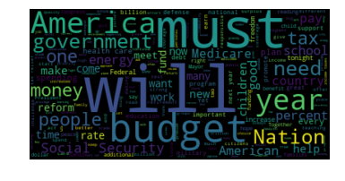
The Speeches-Bush

Slide 8
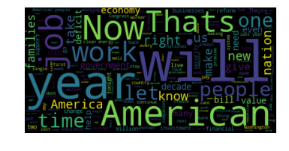
The Speeches-Obama

Slide 9
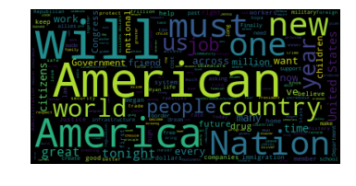
The Speeches-Trump

Slide 10
Party Breakdown

Slide 11
Visualized

Slide 12
Percentage of Action Items by party

Slide 13
Topics
7 topics discovered using the Mallet tool
Domestic Policy, Patriotism, Budget, Value Rhetoric, Finance, Anecdotes, and Foreign Policy

Slide 15
The Models
Linear SVM Models and multinomial Naïve Bayes Models were used to categorize whether a statement made was an action item or rhetoric being used
Two vectorizers were used in both cases, one Unigram, and one uni/bi-gram model

Slide 16
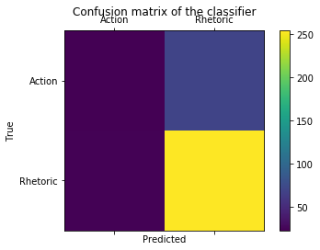
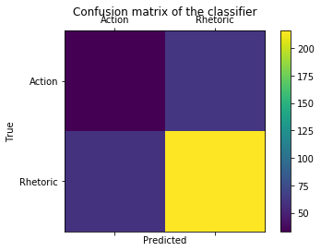
Naïve Bayes
Unigram Model: 75% Accuracy
Uni/Bi gram Model: 75% Accuracy

Slide 17
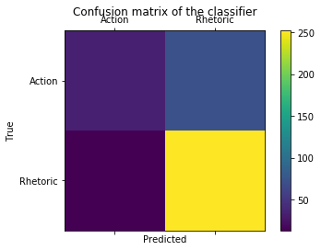
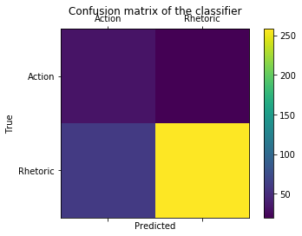
SVM
Unigram Model: 77% Accuracy
Uni/bi gram Model: 78% Accuracy

Slide 18
Conclusions
Possible to pull out Action items from speeches
Results are not satisfactory, would prefer to see an accuracy in the mid 80s
Still better than random chance probability (50%) and marginally better than all in probability (75%)

Slide 19

Questions?

